Slide 1
Advanced 3D graphics for movies and games (NPGR010)
– Monte Carlo integration II
Jiří Vorba, MFF UK/Weta Digital
jirka@cgg.mff.cuni.cz
Slides of prof. Jaroslav Křivánek, minor edits by Jiří Vorba

Slide 2
Recap previous lecture
Monte Carlo integration I

Slide 3
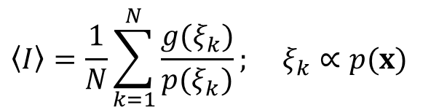


Monte Carlo integration
General tool for estimating definite integrals
Integral:
g(x)
$$I=\int{g(x)dx}$$
Monte Carlo estimate of I:
$$\left\langle I\right\rangle =\frac{1}{N}\sum_{k=1}^{N}{\frac{g(ξ_{k})}{p(ξ_{k})}}; ξ_{k}∝p(x)$$
p(x)
0
ξ₅
ξ₃
ξ₁
ξ₄
ξ₂
ξ₆
1
Works “on average”:
$$E[\left\langle I\right\rangle ]=I$$

Slide 4
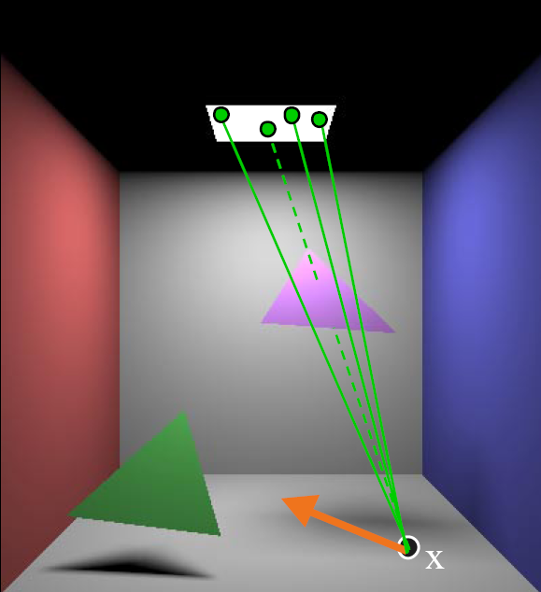
Direct illumination – light source sampling

Slide 5
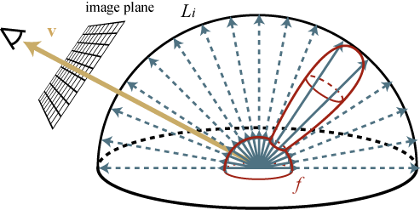
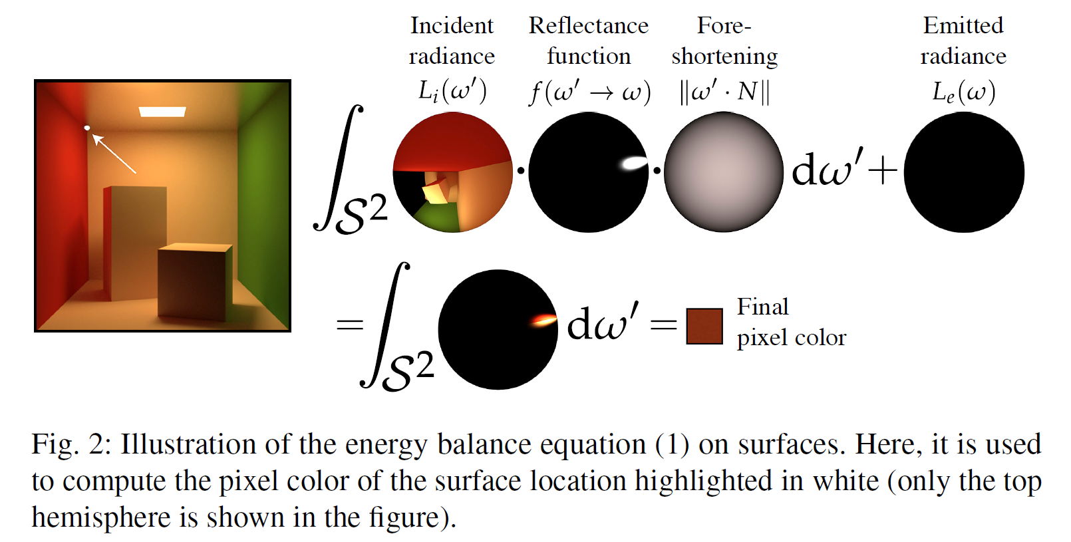

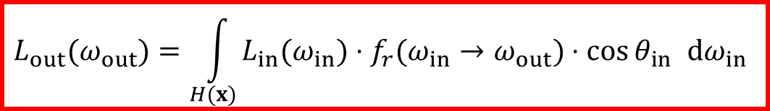


Recap –
Reflection equation
$$L_{out}$$
$$L_{in}$$
Total reflected radiance: integrate contributions of incident radiance, weighted by the BRDF, over the hemisphere
$$L_{out}(ω_{out})=\int_{H(x)}{L_{in}(ω_{in})⋅f_{r}(ω_{in}→ω_{out})⋅\cos{θ_{in}} dω_{in}}$$
upper hemisphere over x
$$=\int{}$$

Slide 6
Generating samples from a distribution
PBRT 13.3
http://www.pbr-book.org/3ed-2018/Monte_Carlo_Integration/Sampling_Random_Variables.html#

Slide 7
Generating samples from a 1D discrete random variable
Given a probability mass function p(i), and the corresponding cdf P(i)
Procedure
  Generate u from Uniform(0,1)
  Choose x_{i} for which
  (we define P(0) = 0)
The search is usually implemented by interval bisection
CDF

Slide 8
Generating samples from a 2D discrete random variable
  Given a probability mass function p_{I,J}(i, j)
Option 1:
  Interpret the 2D PMF as a 1D vector of probabilities
  Generate samples as in the 1D case

Slide 9
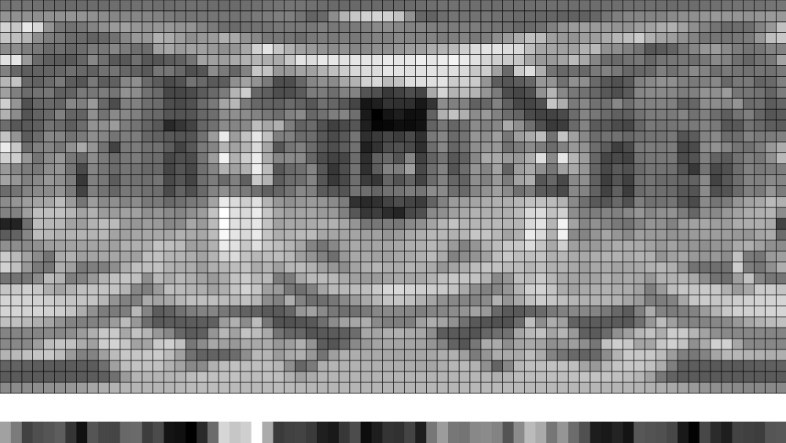
Generating samples from a 2D discrete random variable

Slide 10
Generating samples from a 2D discrete random variable
Option 2 (better)
  “Column” i_{sel} is sampled from the marginal distribution, given by a 1D marginal pmf
  “Row” j_{sel} is sampled from the conditional distribution corresponding to the “column” i_{sel}

Slide 11
Generating samples from a 1D continuous random variable
Option 1: Transformation method
Option 2: Rejection sampling
Option 3: Metropolis-Hastings sampling
  Separate lecture

Slide 12
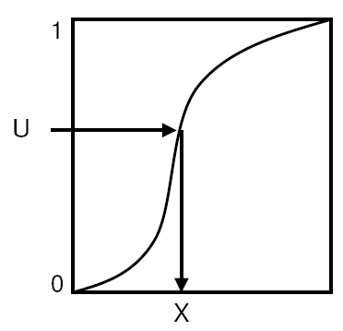

Transformation method
Theorem Consider a random
variable U from the uniform
distribution U (0, 1).
Then the random variable X
has the distribution given by the cdf P.
To generate samples according to a given pdf p, we need to be able to:
  calculate the cdf P(x) from the pdf p(x)
  calculate the inverse cdf P⁻¹(u)
(analytically, on paper)
$$X=P^{−1}(U)$$

Slide 13












Example – U(a,b)
$$\frac{1}{b−a}$$
Given pdf
Calculate cdf
Calculate inversion
Exercise: Derive cdf for Exp(a,b)
$$p\left(x\right)=\frac{1}{b−a}$$
$$a$$
$$b$$
$$P\left(x\right)= \int_{a}^{x}{p\left(x\right)dx= \frac{1}{b−a}\int_{a}^{x}{dx=\frac{1}{b−a}{\left[x\right]}_{a}^{x}=}}$$
$$\frac{x−a}{b−a}$$
$$1$$
$$ξ= \frac{x−a}{b−a}$$
$$P^{−1}\left(ξ\right)=a+ξ(b−a)$$
$$a$$
$$b$$

Slide 14
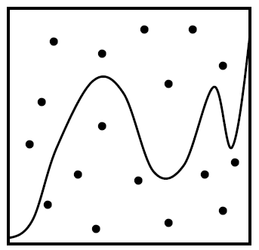
Rejection sampling in 1D
MAX
Algorithm
  Choose random u₁ from Uniform(a, b)
  Choose random u₂ from Uniform(0, MAX)
  Accept the sample if p(u₁) > u₂
    Return u₁ as the generated random number
  Repeat until a sample is accepted
Theorem The accepted samples follow the distribution with the pdf p(x).
Efficiency = % of accepted samples
  Area under the pdf graph / area of the bounding rectangle
p(x)
0
a
b

Slide 15
Transformation method vs.
Rejection sampling
  Transformation method: Pros
    Almost always more efficient than rejection sampling (unless the transformation formula x = P⁻¹(u) turns out extremely complex)
    Constant time complexity. The number of random generator invocations is known upfront (important for SW architecture).
  Transformation method: Cons
    May not be feasible (we may not be able to find the suitable form for x = P⁻¹(u) analytically), but rejection sampling is always applicable as long as we can evaluate and bound the pdf (i.e. rejection sampling is more general)
  Smart rejection sampling can be very efficient (e.g. the Ziggurat method, see Wikipedia, https://en.wikipedia.org/wiki/Ziggurat_algorithm)

Slide 16
Sampling from a 2D continuous random variable
Conceptually similar to the 2D discrete case
Procedure
  Given the joint density p_{X,Y}(x, y) = p_{X}(x) p_{Y|X}(y | x)
  Choose x_{sel} from the marginal pdf
  Choose y_{sel} from the conditional pdf

Slide 17
EXAMPLE 2D Euclidean derivation

Slide 18
EXAMPLE derivation
On the (hemi)sphere

Slide 19
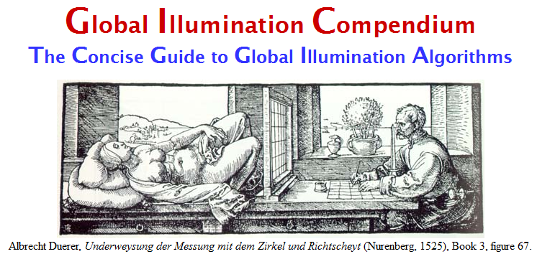
Transformation formulas for common cases in light transport
P. Dutré: Global Illumination Compendium, http://people.cs.kuleuven.be/~philip.dutre/GI/
PBRT, Section 13.6.
http://www.pbr-book.org/3ed-2018/Monte_Carlo_Integration/2D_Sampling_with_Multidimensional_Transformations.html

Slide 20
Importance sampling from the physically-plausible Phong BRDF
Ray hits a surface with a Phong BRDF. How do we generate a ray direction proportional to the BRDF lobe?
Procedure
  Choose the BRDF component (diffuse reflection, specular reflection, possibly refraction)
  Sample direction from the selected component
  Evaluate the total PDF and BRDF

Slide 21

Recap: Physically-plausible Phong BRDF
Where
Energy conservation:
$$f_{r}^{\text{Phong}}(ω_{in}→ω_{out})=\frac{ρ_{d}}{π}+\frac{n+2}{2π}ρ_{s}\max{\{}0,\cos{θ_{refl}}\}^{n}$$
$$\cos{θ_{refl}}=ω_{out}⋅ω_{refl}$$
$$ω_{refl}=2(ω_{in}⋅n)n−ω_{in}$$
$$ρ_{d}+ρ_{s}≤1$$

Slide 22
Selection of the BRDF component
  float probDiffuse = max(rhoD.r, rhoD.g, rhoD.b);
  float prodSpecular = max(rhoS.r, rhoS.g, rhoS.b);
  float normalization = 1.f / (probDiffuse + probSpecular);
  // probability of choosing the diffuse component
  probDiffuse *= normalization;
  // probability of choosing the specular component
  probSpecular *= normalization;
  if ( uniformRand(0,1) <= probDiffuse )
    generatedDir = sampleDiffuse();
  else
    generatedDir = sampleSpecular(incidentDir);
  pdf = evalPdf(incidentDir, generatedDir,
  probDiffuse, probSpecular);

Slide 23
What is incDir and genDir in a path and light tracer

Slide 24
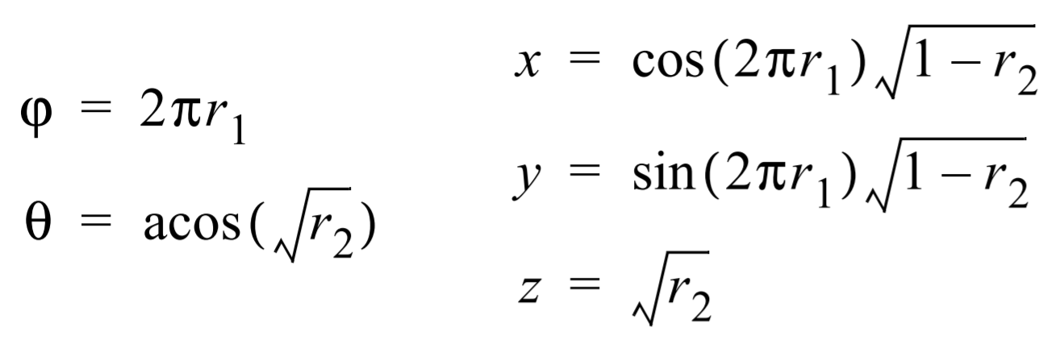
Sampling of the diffuse lobe
Importance sampling with the density p(θ) = cos(θ) / π
  θ …angle between the surface normal and the generated ray
  Generating the direction:
    r1, r2 … uniform random variates on <0,1)
Reference: Dutre, Global illumination Compendium
Derivation: Pharr & Humphreys, PBRT (Sec. 13.6.3. – projecting from disk)

Slide 25
sampleDiffuse()
// generate spherical coordinates of the direction
const float r1 = uniformRand(0,1), r2 = uniformRand(0,1);
const float sinTheta = sqrt(1 – r2);
const float cosTheta = sqrt(r2);
const float phi = 2.0*PI*r1;
// convert [theta, phi] to Cartesian coordinates
Vec3 dir (cos(phi)*sinTheta, sin(phi)*sinTheta, cosTheta);
return dir;
Here the generated direction is in the coordinate frame with the z-axis aligned
to the surface normal (i.e. the local shading frame).

Slide 26
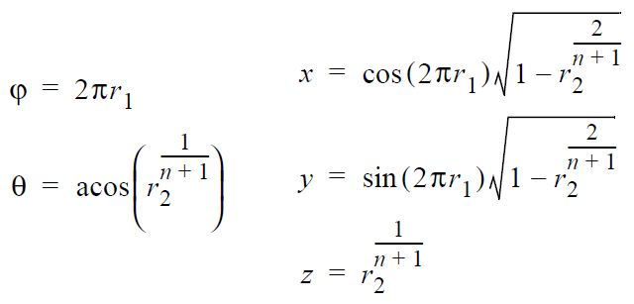
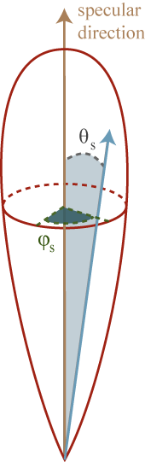
Sampling of the specular (glossy) component
Importance sampling with the pdf p(θ_{refl}) = (n+1)/(2π) cos^{n}(θ)
  θ_{refl} …angle between the ideal mirror reflection of ω_{out} and the generated ray
  Formulas for generating the direction:
    r1, r2 … uniform random variates on <0,1)

Slide 27
sampleSpecular()
// build a lobe coordinate frame with ideal reflected direction = z-axis
Frame lobeFrame;
lobeFrame.setFromZ( reflectedDir(incidentDir, surfaceNormal) );
// generate direction in the lobe coordinate frame
// use formulas form previous slide, n=Phong exponent
const Vec3 dirInLobeFrame = rndHemiCosN(n);
// transform dirInLobeFrame to local shading frame
const Vec3 dir = lobeFrame.toGlobal(dirInLobeFrame);
return dir;

Slide 28
evalPdf
float evalPdf(Dir incidentDir, Dir generatedDir,
float probDiffuse, float probSpecular)
{
return
probDiffuse * getDiffusePdf(generatedDir) +
probSpecular * getSpecularPdf(incidentDir, generatedDir);
}
formulas from previous slides

Slide 29
Variance reduction methods for MC estimators

Slide 30
Variance reduction methods
Importance sampling
  The most commonly used method in light transport (most often we use BRDF-proportional importance sampling)
Control variates
Improved sample distribution
  Stratification
  quasi-Monte Carlo (QMC)

Slide 31
Importance sampling
g(x)
p(x)
0
X₅
X₃
X₁
X₄
X₂
X₆
1

Slide 32
Importance sampling
Parts of the integration domain with high value of the integrand g are more important
  Samples from these areas have higher impact on the result
Importance sampling places samples preferentially to these areas
  i.e. the pdf p is “similar” to the integrand g
Decreases variance while keeping unbiasedness

Slide 33
Control variates
g(x)
h(x)
0
g(x)-h(x)
0
1

Slide 34

Control variates
Consider a function h(x), that approximates the
integrand and we can integrate it analytically:
$$I= \int{g\left(x\right) dx} = \int{\left[g\left(x\right)−h\left(x\right)\right] dx}+\int{h\left(x\right) dx}$$
Numerical integration (MC)
Hopefully with less variance
than integrating g(x) directly.
We can integrate
analytically

Slide 35
Control variates vs. Importance sampling
Importance sampling
  Advantageous whenever the function, according to which we can generate samples, appears in the integrand as a multiplicative factor (e.g. BRDF in the reflection equation).
Control variates
  Better if the function that we can integrate analytically appears in the integrand as an additive term.
This is why in light transport; we almost always use importance sampling and rarely control variates.

Slide 36
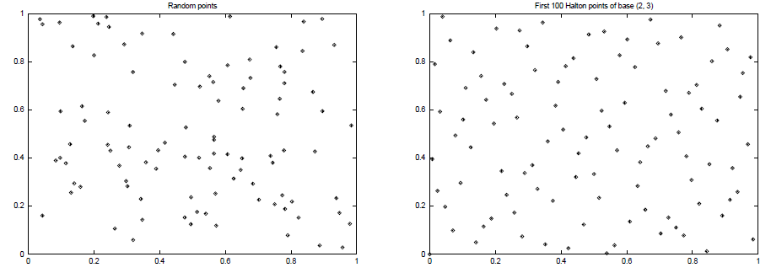
Better sample distribution
Generating independent samples often
leads to clustering of samples
  Results in high estimator variance
Better sample distribution => better
coverage of the integration domain
by samples => lower variance
Approaches
  Stratified sampling
  quasi-Monte Carlo (QMC)

Slide 37
Stratified sampling
Sampling domain subdivided into disjoint areas that are sampled independently
g(x)
g(x_{k})
0
x₁
x₂
x₃
x₄
1

Slide 38
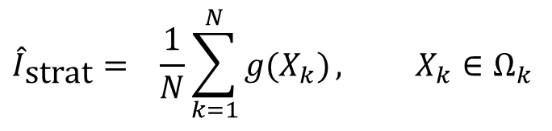
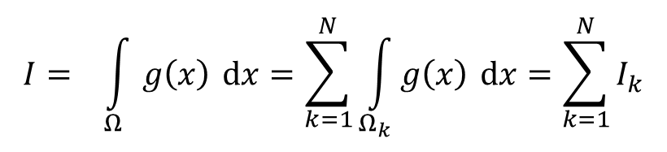
Stratified sampling
Subdivision of the sampling domain Ω into N parts Ω_{k}:
$$I= \int_{Ω}{g\left(x\right) dx}=\sum_{k=1}^{N}{\int_{Ω_{k}}{g\left(x\right) dx}}=\sum_{k=1}^{N}{I_{k}}$$
Resulting estimator:
$${\hat{I}}_{\text{strat}}= \frac{1}{N}\sum_{k=1}^{N}{g(X_{k})}, X_{k}∈Ω_{k}$$

Slide 39
Stratified sampling
Suppresses sample clustering
Reduces estimator variance
  Variance is provably less than or equal to the variance of a regular secondary estimator
Very effective in low dimension
  Effectiveness deteriorates for high-dimensional integrands

Slide 40
How to subdivide the interval?
Uniform subdivision of the interval
  Natural approach for a completely unknown integrand g
If we know at least roughly the shape of the integrand g, we aim for a subdivision with the lowest possible variance on the sub-domains
Subdivision of a d-dimensional interval leads to N^{d} samples
  A better approach in high dimension is N-rooks sampling

Slide 41
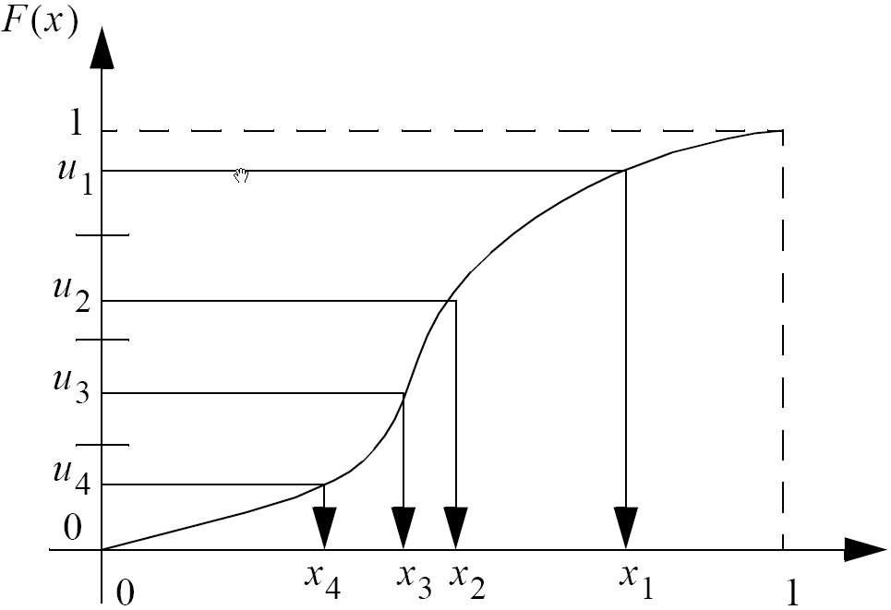
Combination of stratified sampling and the transformation method
Transformation through
the inverse cdf
Stratification in the space
of random numbers

Slide 42
Quasi-Monte Carlo methods (QMC)
Use of strictly deterministic sequences instead of (pseudo-)random numbers
Pseudo-random numbers replaced by low-discrepancy sequences
Everything works as in regular MC, but the underlying math is different (nothing is random so the math cannot be built on probability theory)

Slide 43
Discrepancy
High Discrepancy
(clusters of points)
Low Discrepancy
(more uniform)

Slide 44
Stratified sampling
Henrik Wann Jensen
10 paths per pixel

Slide 45
Quasi-Monte Carlo
Henrik Wann Jensen
10 paths per pixel

Slide 46
Same random sequence for all pixels
Henrik Wann Jensen
10 paths per pixel

Slide 47
Image-based lighting

Slide 48
Image-based lighting
Introduced by Paul Debevec (Siggraph 98)
Routinely used for special effects in films & games

Slide 49
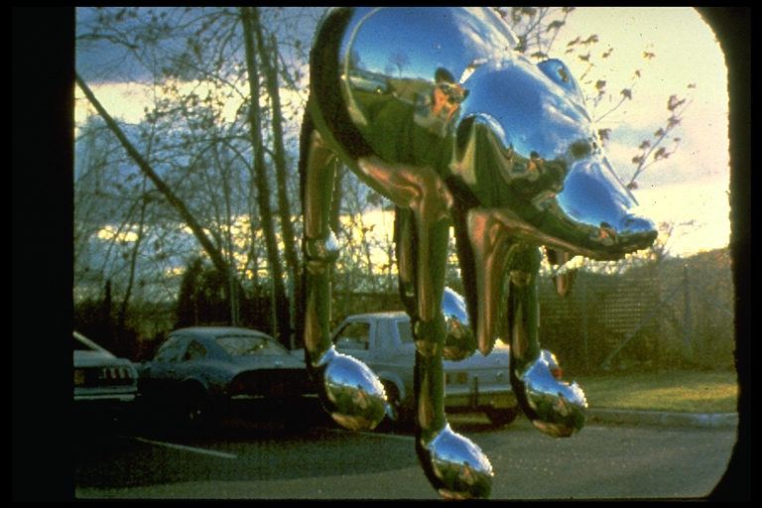
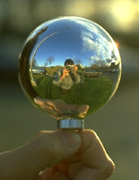
Environment mapping (a.k.a. image-based lighting, reflection mapping)
Miller and Hoffman, 1984
Later, Greene 86, Cabral et al, Debevec 97, …

Slide 50
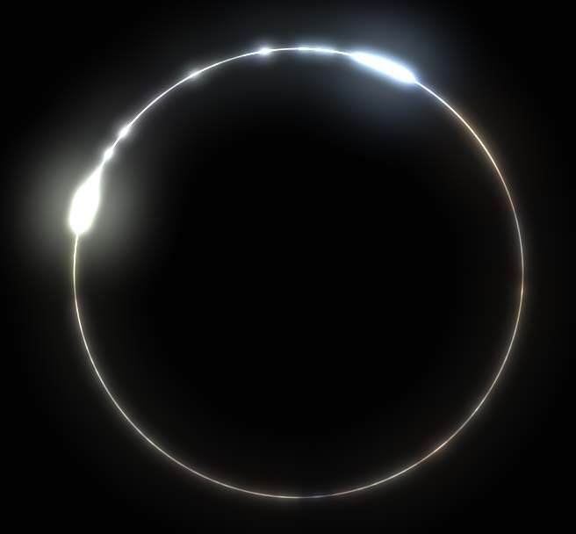
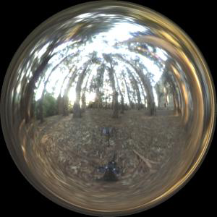
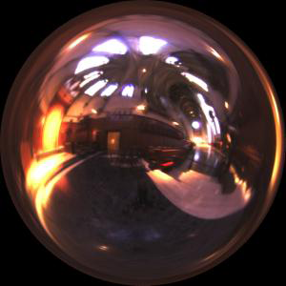
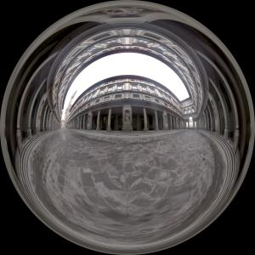
Image-based lighting
Illuminating CG objects using measurements of real light (=light probes)
Light
Eucaliptus
grove
Grace
cathedral
Object
Uffizi
gallery
© Paul Debevec

Slide 51
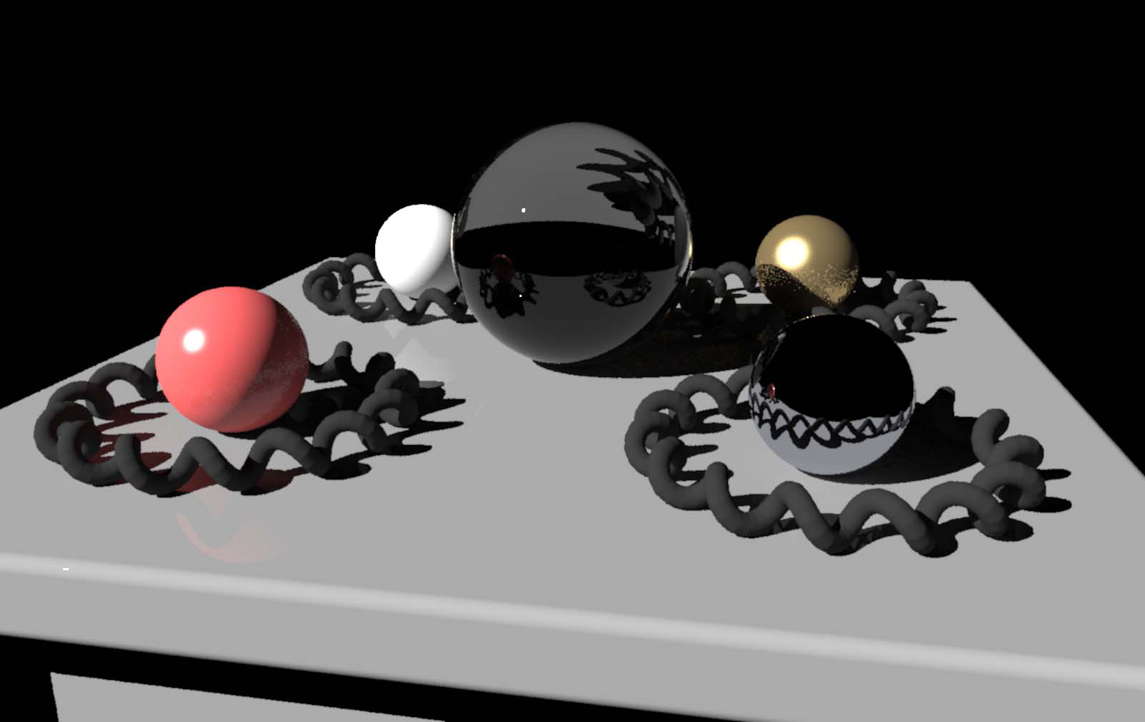
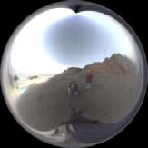
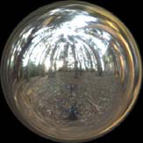
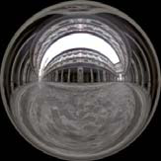

Point lighting
© Paul
Debevec

Slide 52
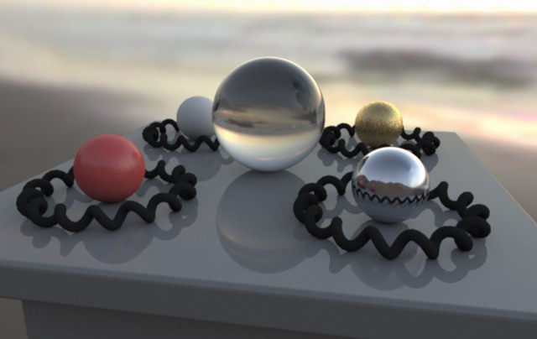
Image-based lighting
© Paul
Debevec

Slide 53
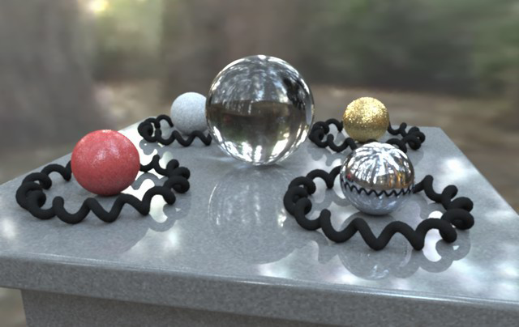
Image-based lighting
© Paul
Debevec

Slide 54
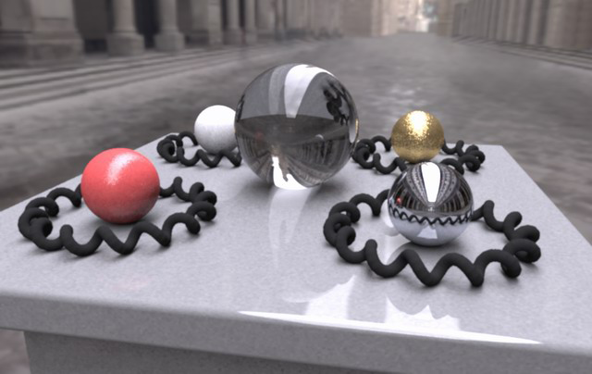
Image-based lighting
© Paul
Debevec

Slide 55
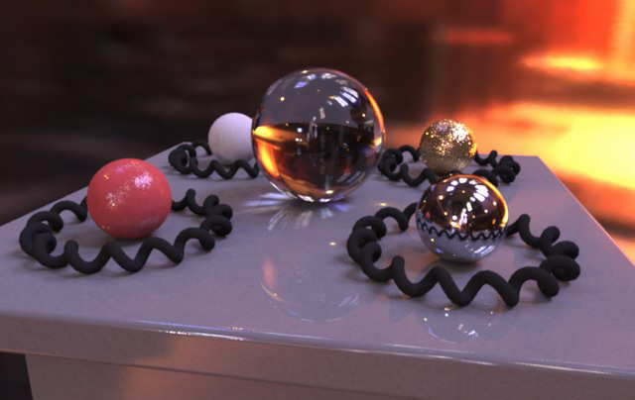
Image-based lighting
© Paul
Debevec

Slide 56
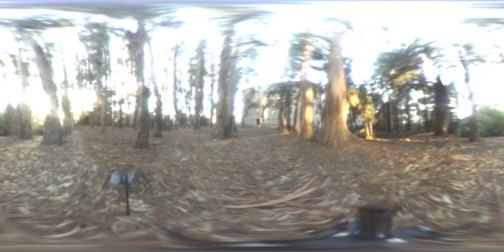
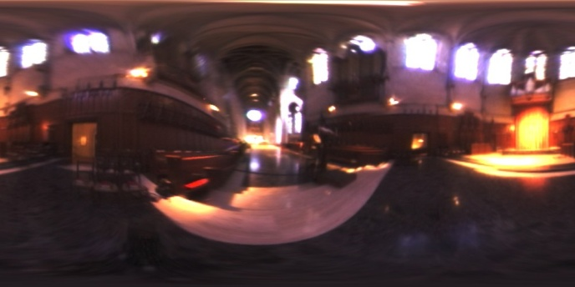
Mapping
Eucaliptus grove
Grace cathedral
Debevec’s spherical
“Latitude – longitude” (spherical coordinates)
Cube map

Slide 57
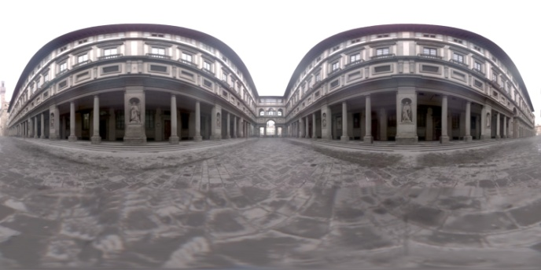
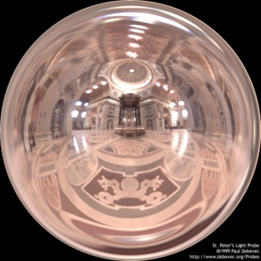
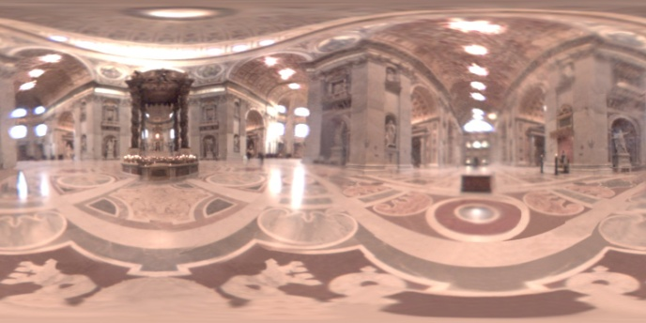
Mapping
Uffizi gallery
St. Peter’s Cathedral
Debevec’s spherical
“Latitude – longitude” (spherical coordinates)
Cube map

Slide 58

Debevec’s spherical mapping
Mapping from direction in Cartesian
coordinates to image UV.
float d = sqrt(dir.x*dir.x + dir.y*dir.y);
float r = d>0 ? 0.159154943*acos(dir.z)/d : 0.0;
u = 0.5 + dir.x * r;
v = 0.5 + dir.y * r;
Quote from “http://ict.debevec.org/~debevec/Probes/”
The following light probe images were created by taking two pictures of a mirrored ball at ninety degrees of separation and assembling the two radiance maps into this registered dataset. The coordinate mapping of these images is such that the center of the image is straight forward, the circumference of the image is straight backwards, and the horizontal line through the center linearly maps azimuthal angle to pixel coordinate.
Thus, if we consider the images to be normalized to have coordinates u=[-1,1], v=[-1,1], we have theta=atan2(v,u), phi=pi*sqrt(u*u+v*v). The unit vector pointing in the corresponding direction is obtained by rotating (0,0,-1) by phi degrees around the y (up) axis and then theta degrees around the -z (forward) axis. If for a direction vector in the world (Dx, Dy, Dz), the corresponding (u,v) coordinate in the light probe image is (Dx*r,Dy*r) where r=(1/pi)*acos(Dz)/sqrt(Dx^2 + Dy^2).

Slide 59
Sampling strategies for image based lighting
Technique (pdf) 1:
BRDF importance sampling
  Generate directions with a pdf proportional to the BRDF
Technique (pdf) 2:
Environment map importance sampling
  Generate directions with a pdf proportional to L(ω) represented by the EM

Slide 60
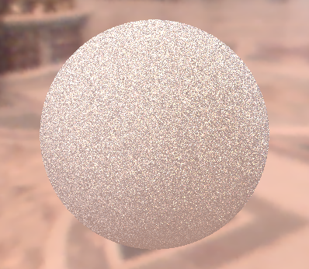
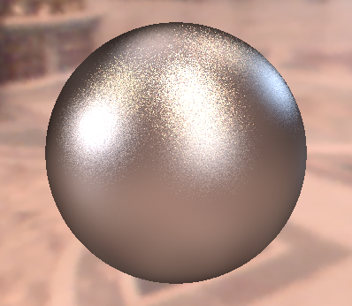
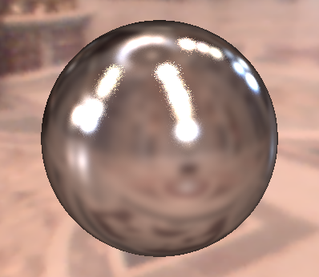
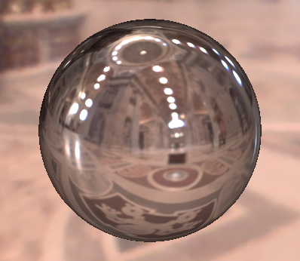
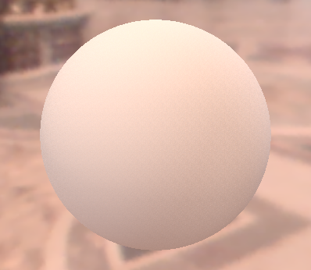
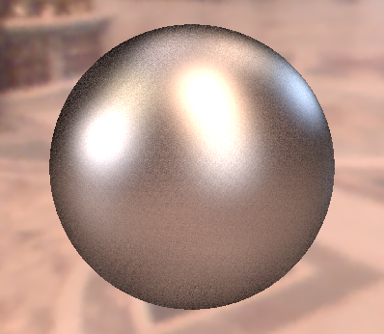
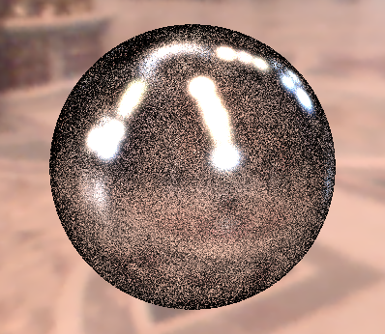
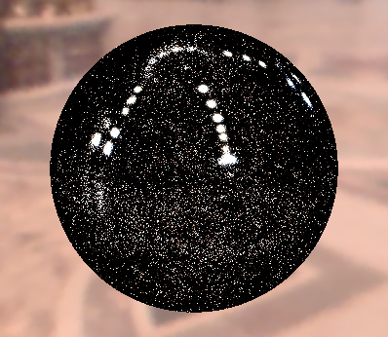




Sampling strategies
BRDF IS
600 samples
EM IS
600 samples
MIS
300 + 300 samples
Diffuse only
Ward BRDF, α=0.2
Ward BRDF, α=0.05
Ward BRDF, α=0.01

Slide 61
Sampling according to the environment map luminance
Luminance of the environment map defines the sampling pdf on the unit sphere
For details, see PBRT, 13.6.7
http://www.pbr-book.org/3ed-2018/Monte_Carlo_Integration/2D_Sampling_with_Multidimensional_Transformations.html#Piecewise-Constant2DDistributions

